Slide 1
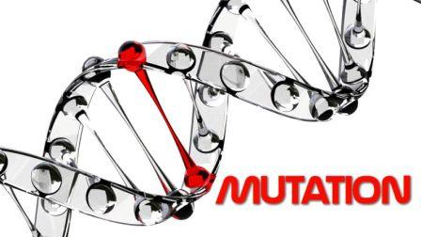
Mehak rafiq
Mutation

Slide 2
History of Mutation:
The word "mutation" means something different to a comic book enthusiast than it does to a genetic researcher.
But even as it pertains to science, the idea of mutation has meant different things over time.
Most geneticists today conceptualize 'mutation' as a change in an individual gene.
Beginning with Darwin and pre-Mendelian ideas of what mutation was, continuing through the Mendelian aspects, work done by Thomas Hunt Morgan with fruit flies, and continuing through to the ideas of mutagenesis,the study of mutation, and mutation in relation to evolution.

Slide 3
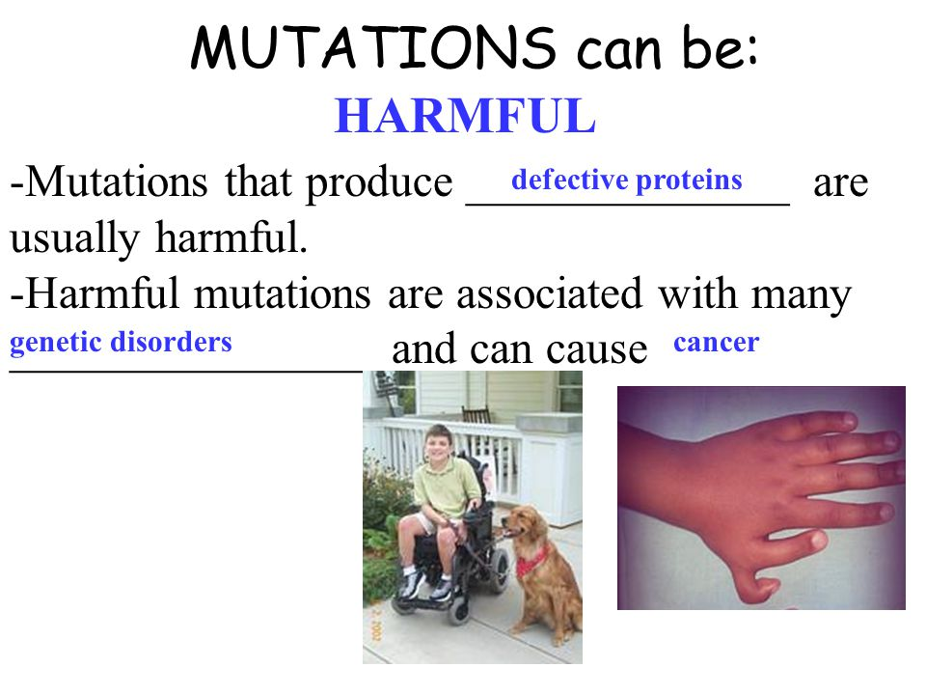
Harmful Mutations:

Slide 4
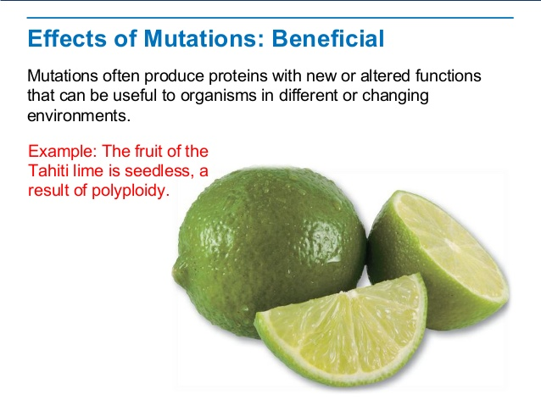
Beneficial Mutations:

